Slide 1
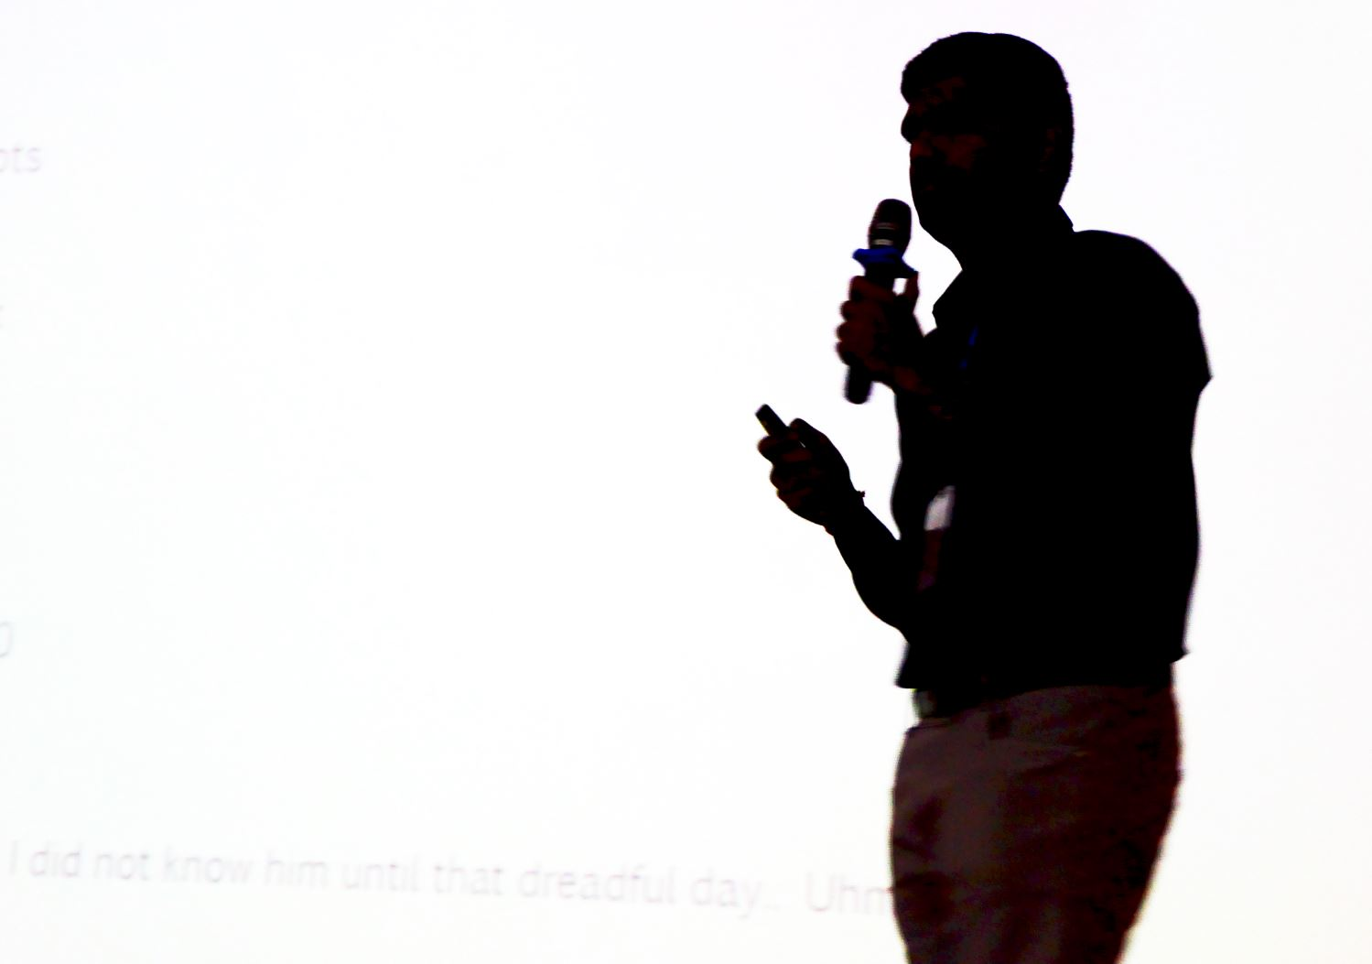

Slide 3
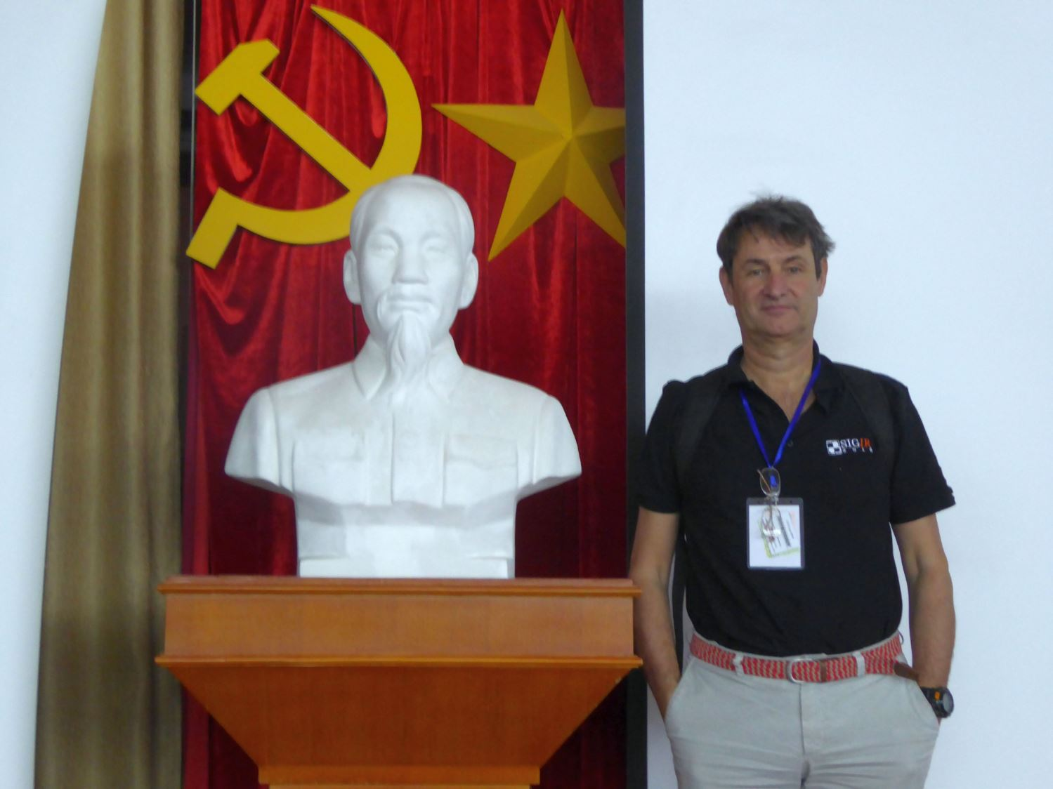

Slide 5
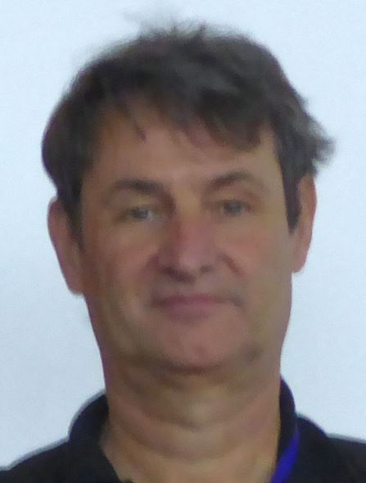
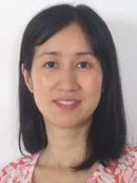
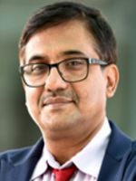
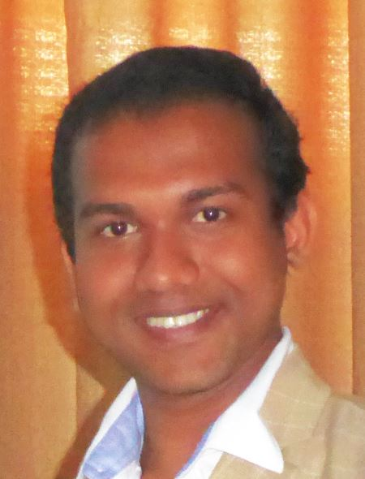

Slide 6
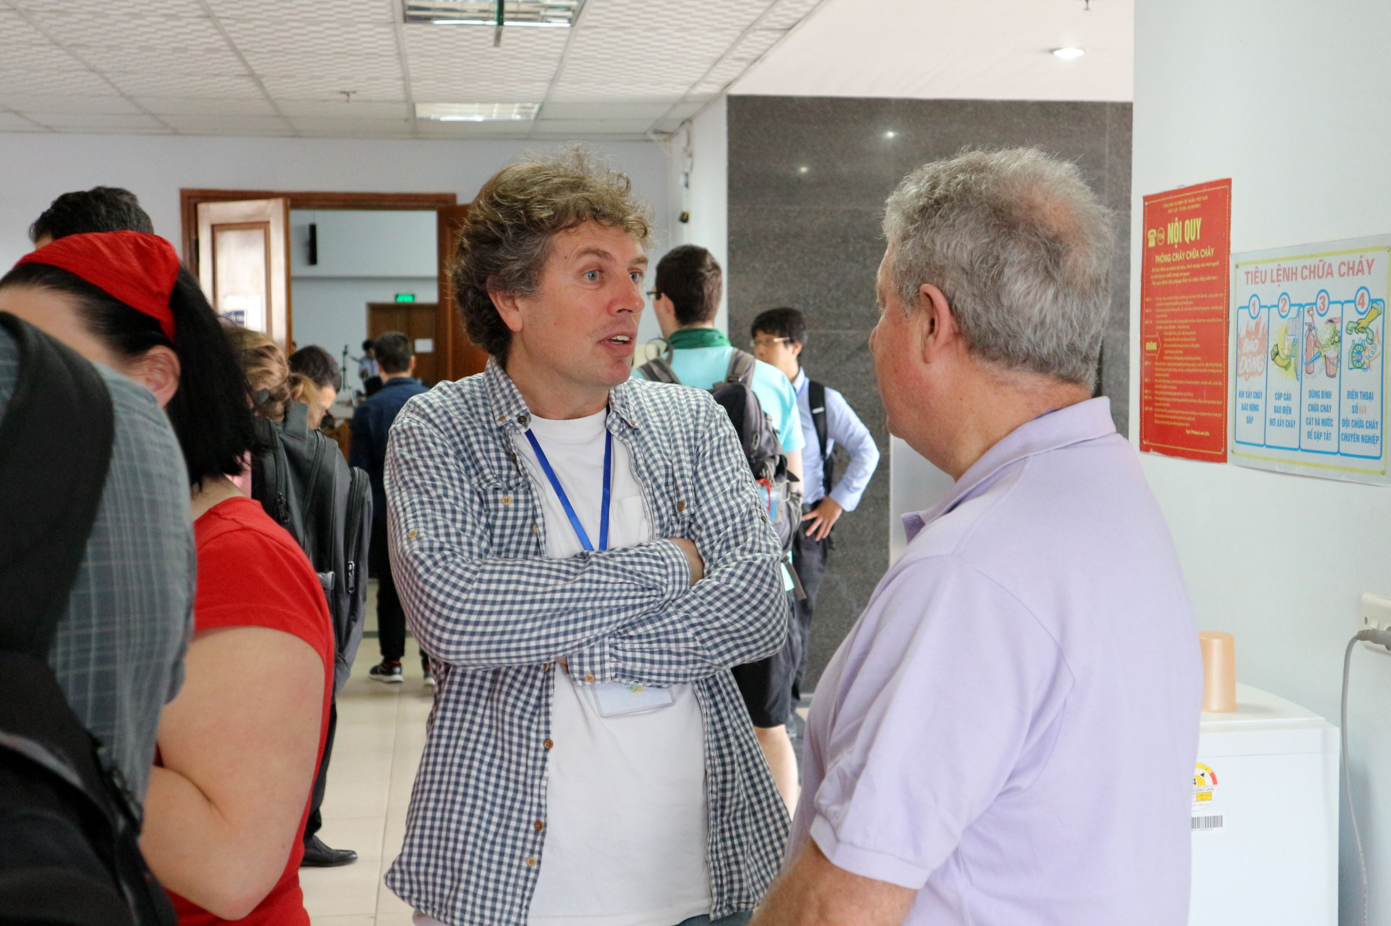

Slide 7
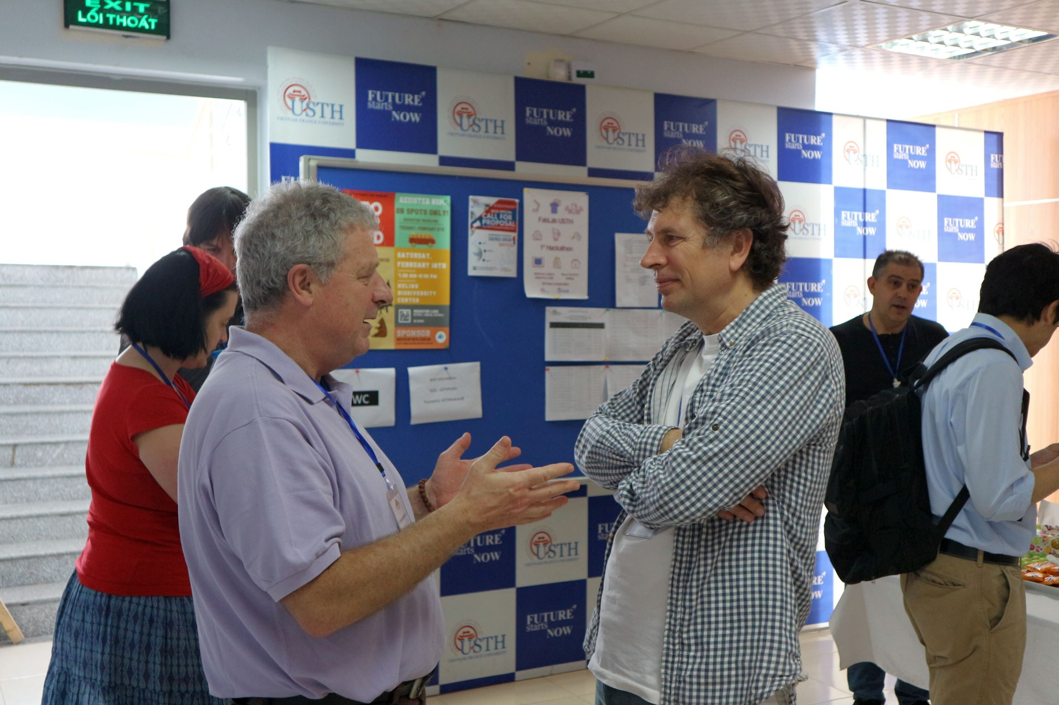

Slide 8
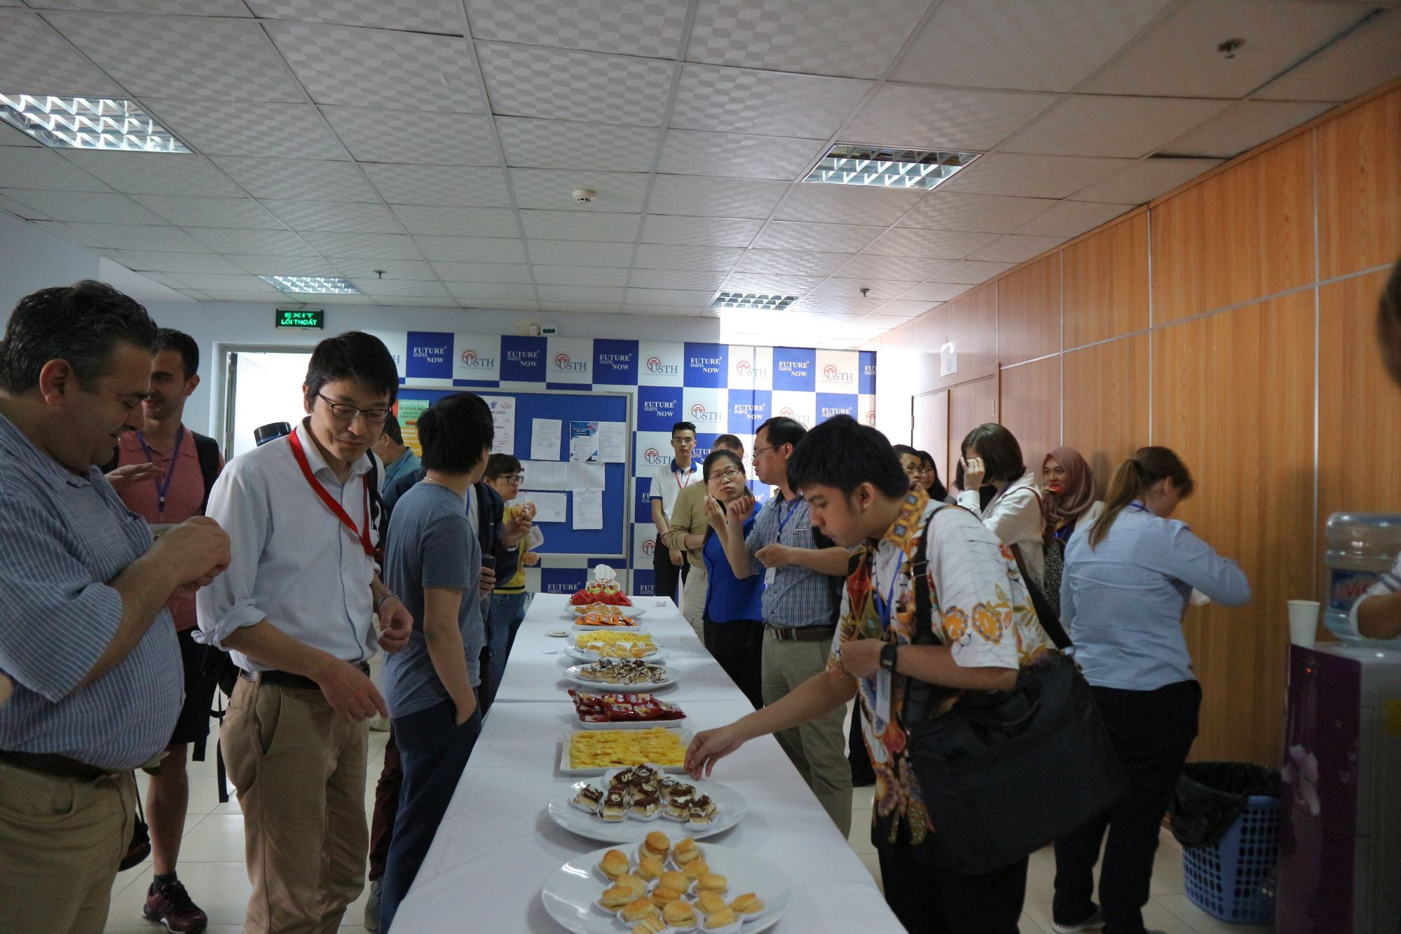

Slide 9
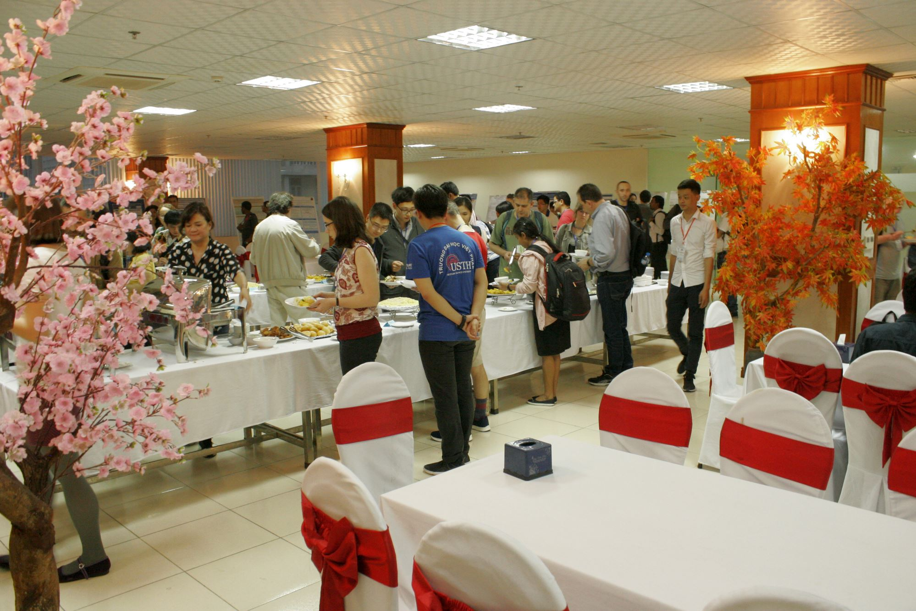

Slide 10
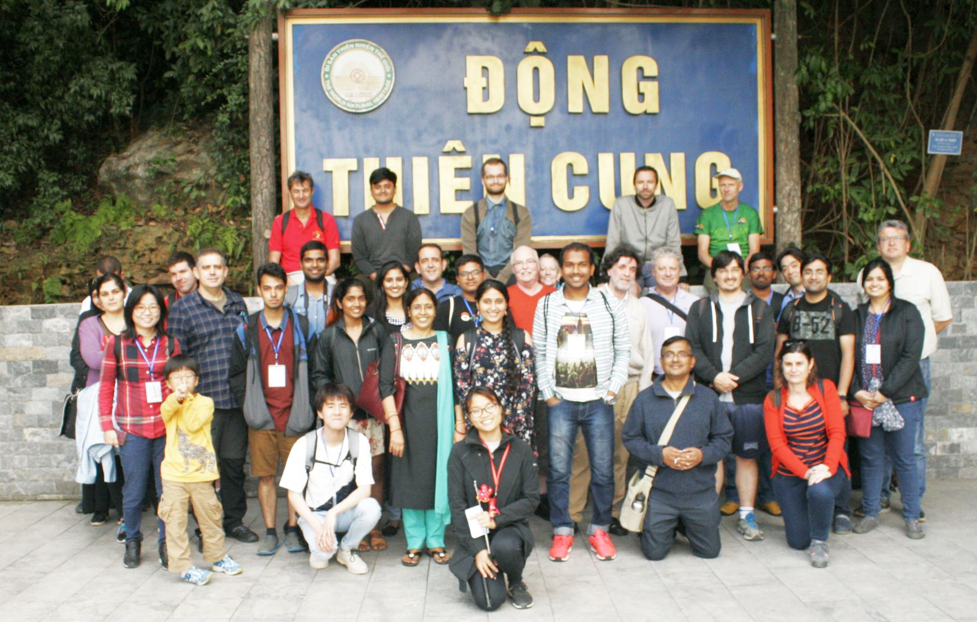

Slide 11
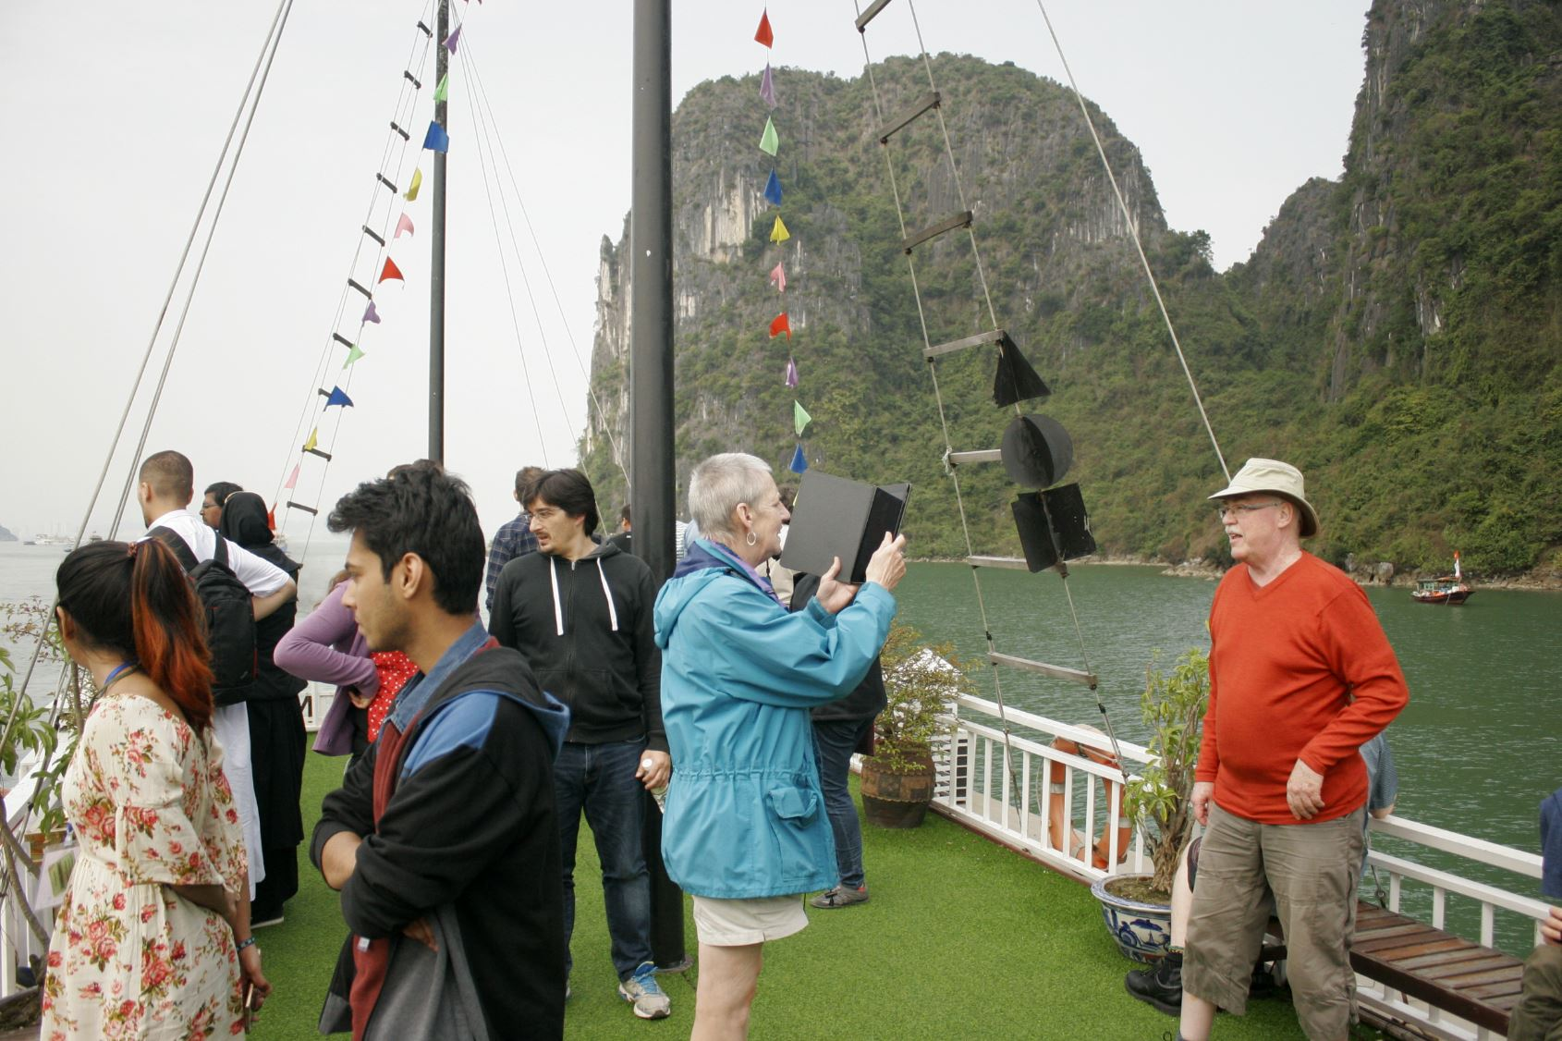

Slide 14
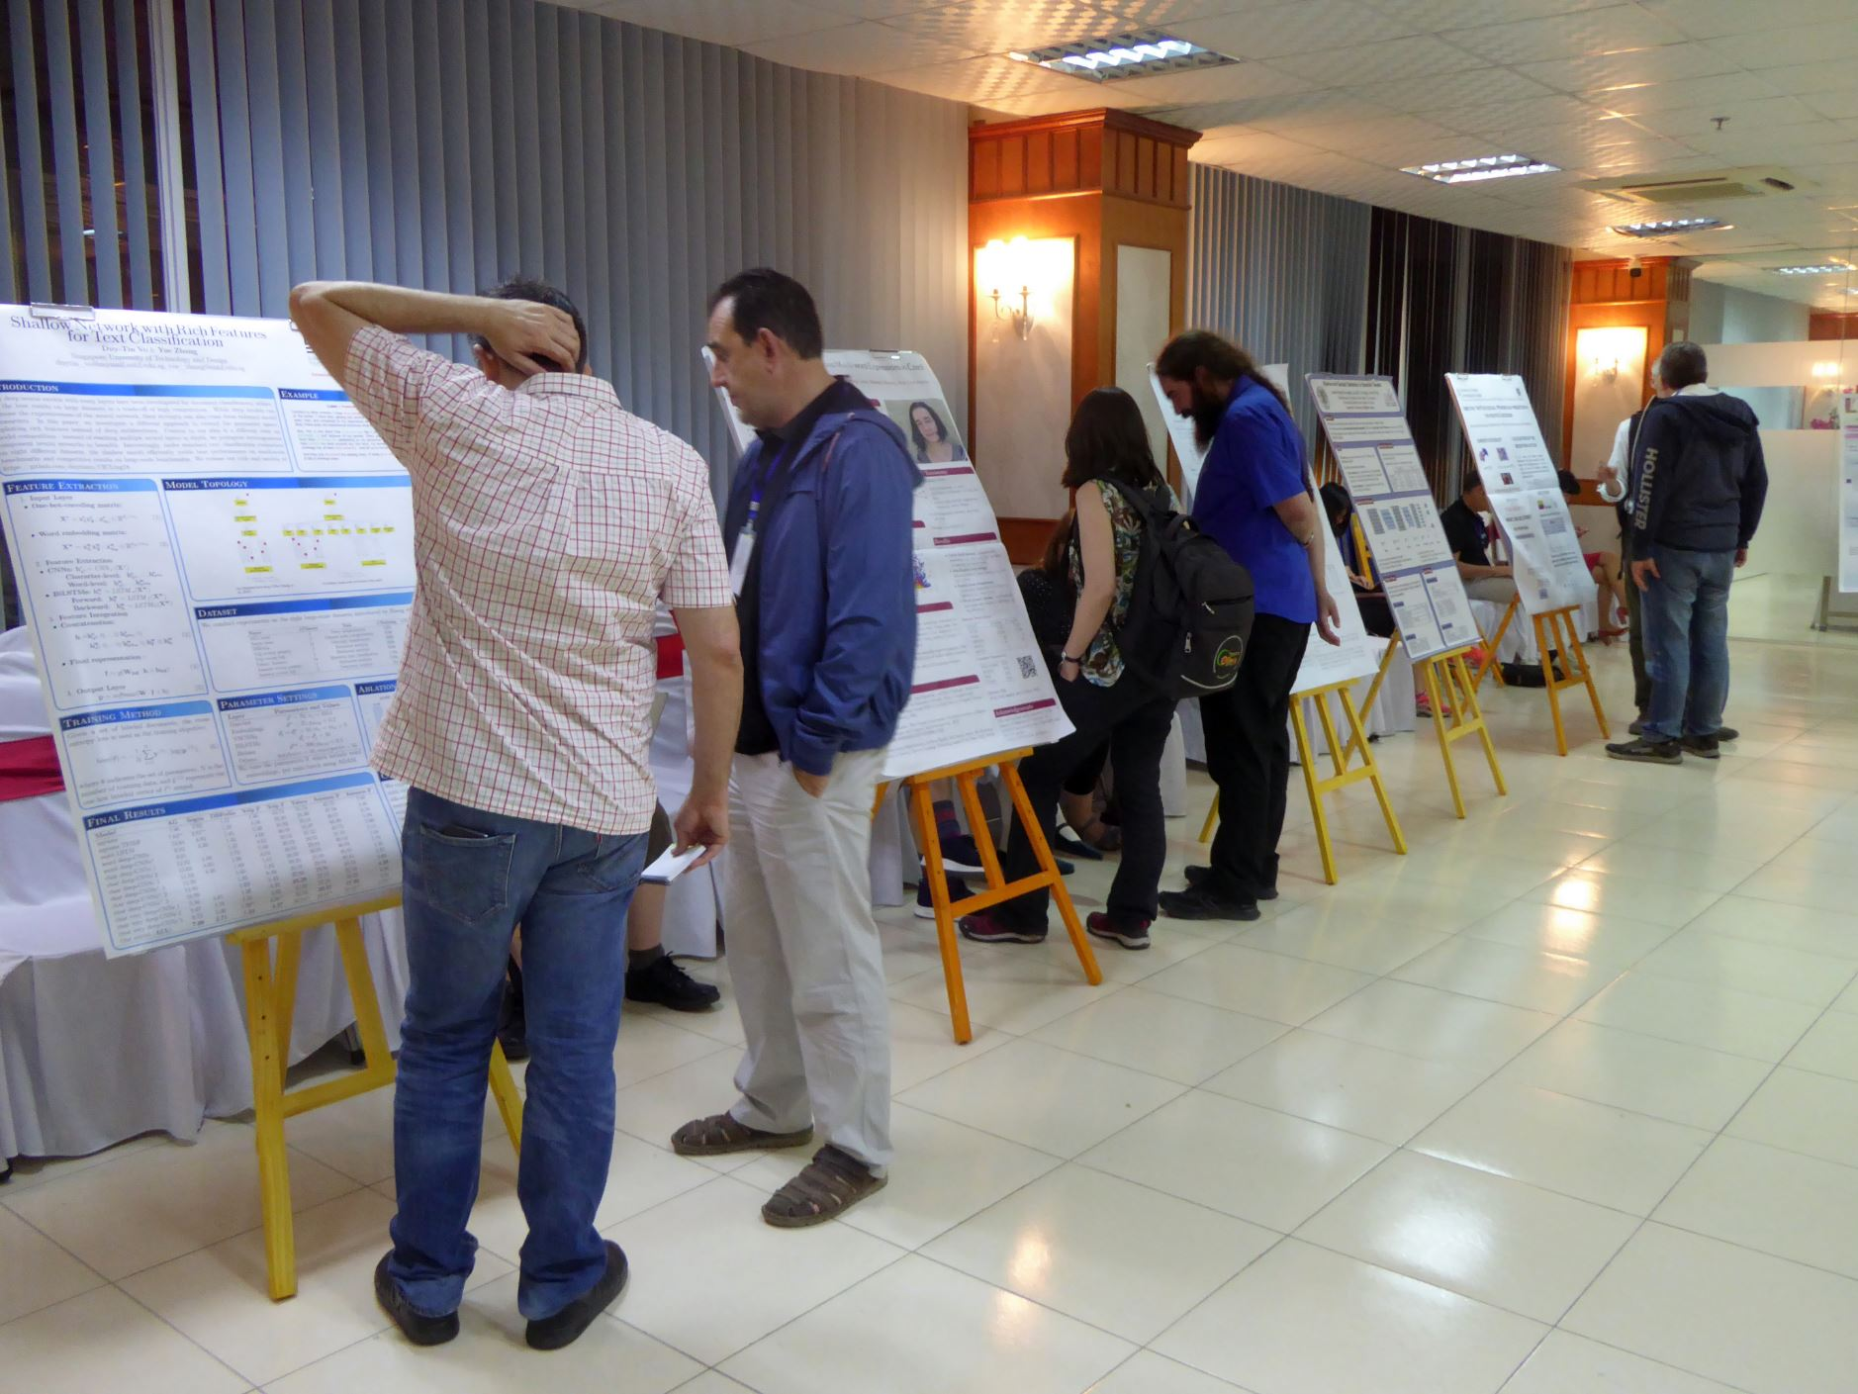

Slide 15
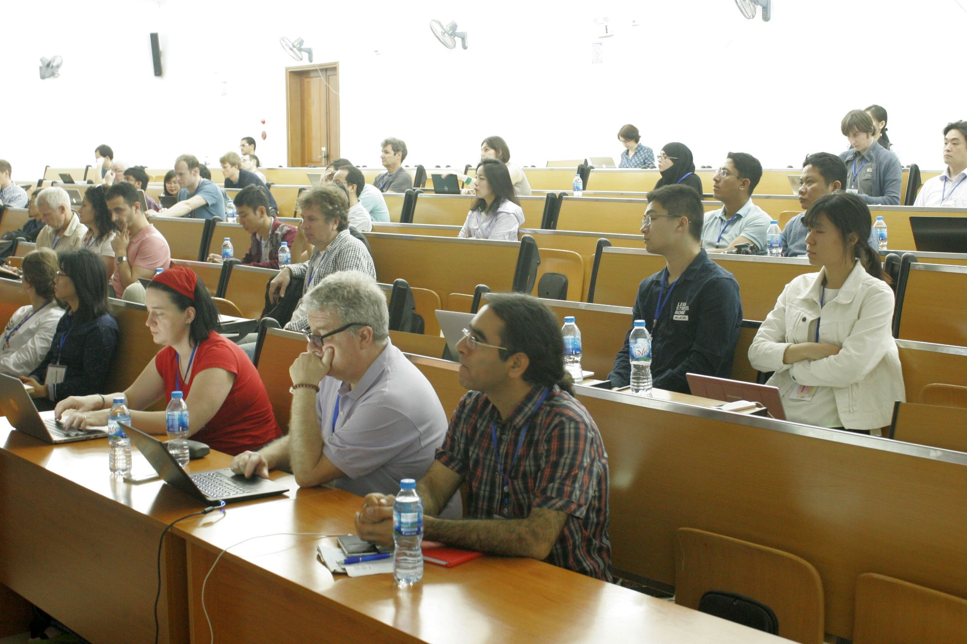

Slide 17
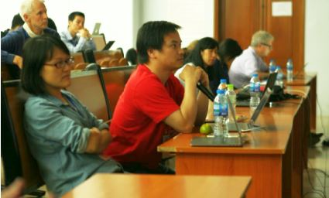

Slide 18
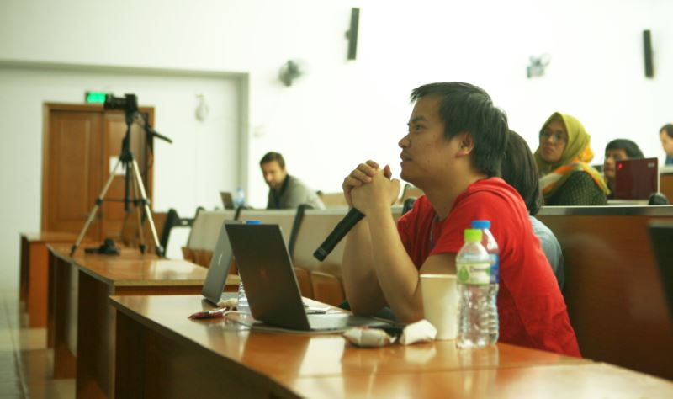

Slide 19
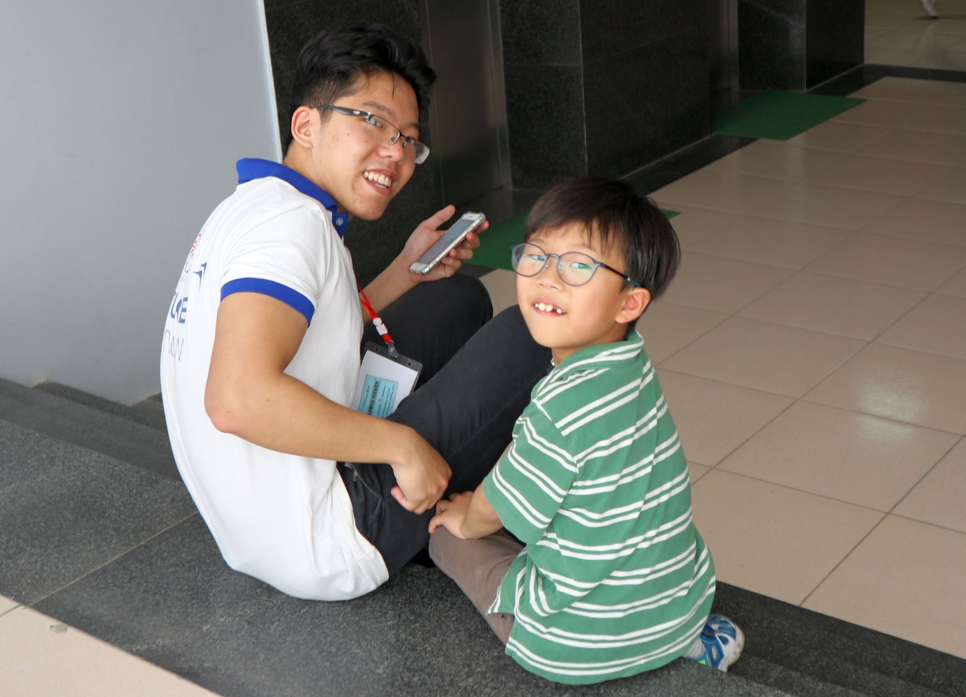

Slide 20
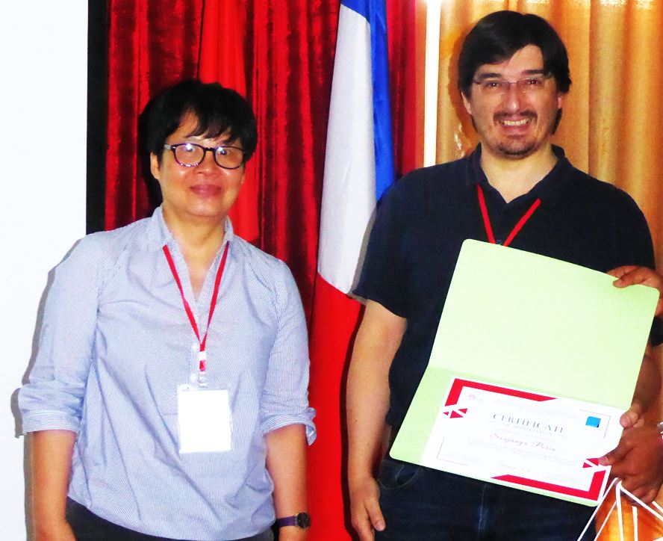

Slide 21
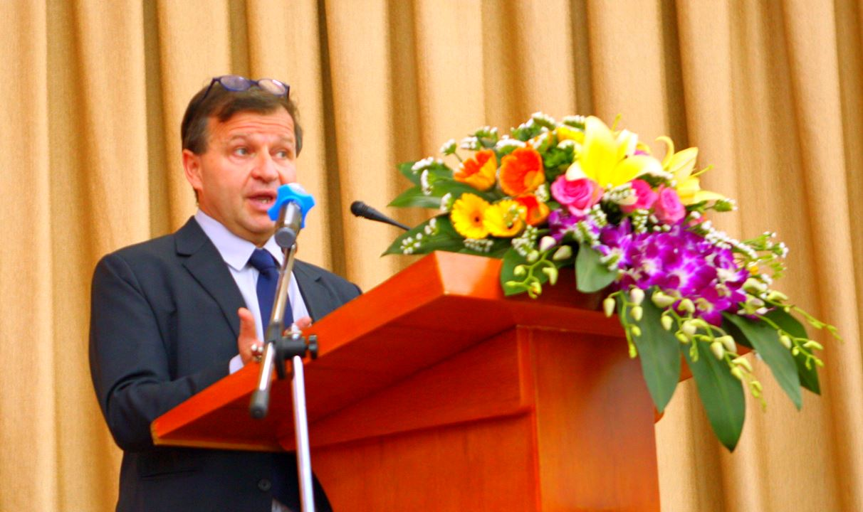
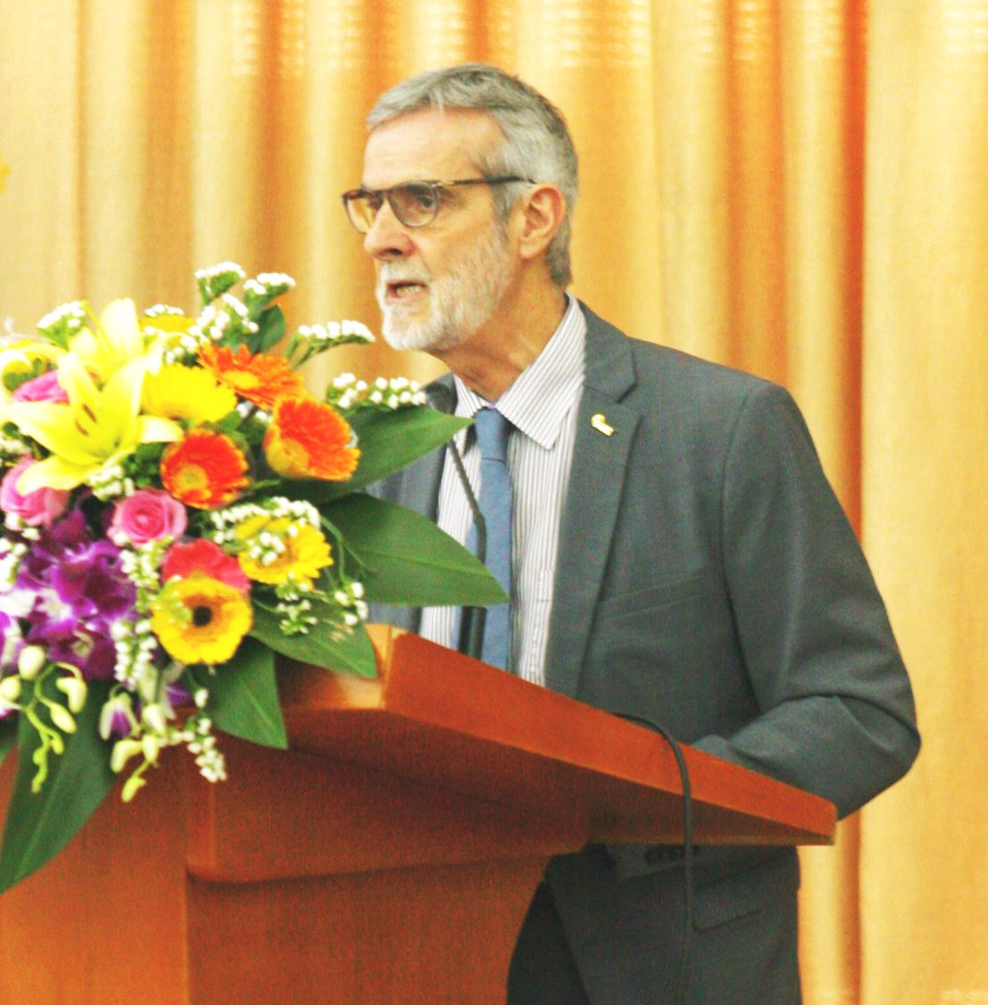

Slide 22
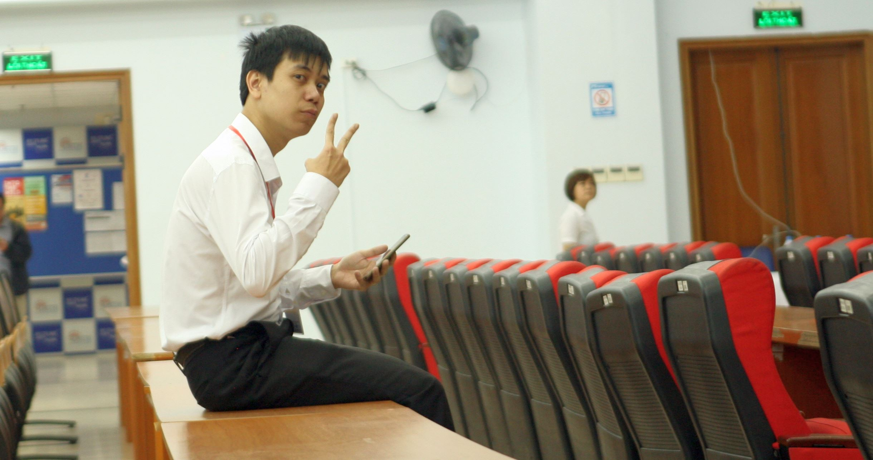

Slide 23
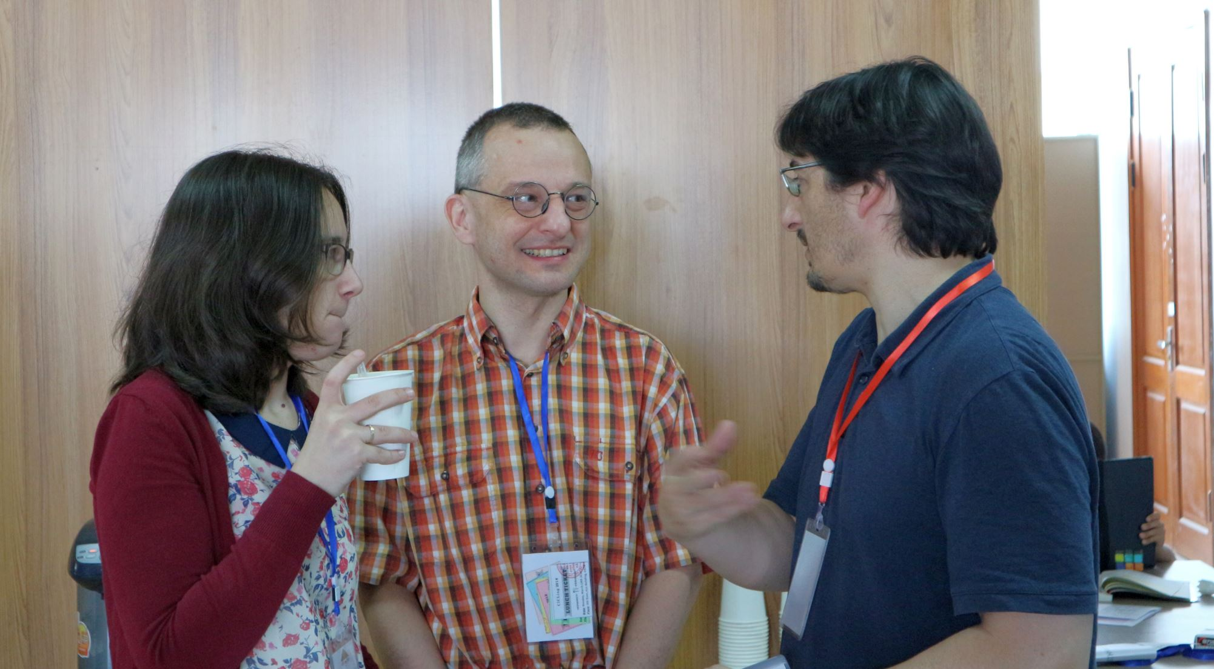

Slide 24
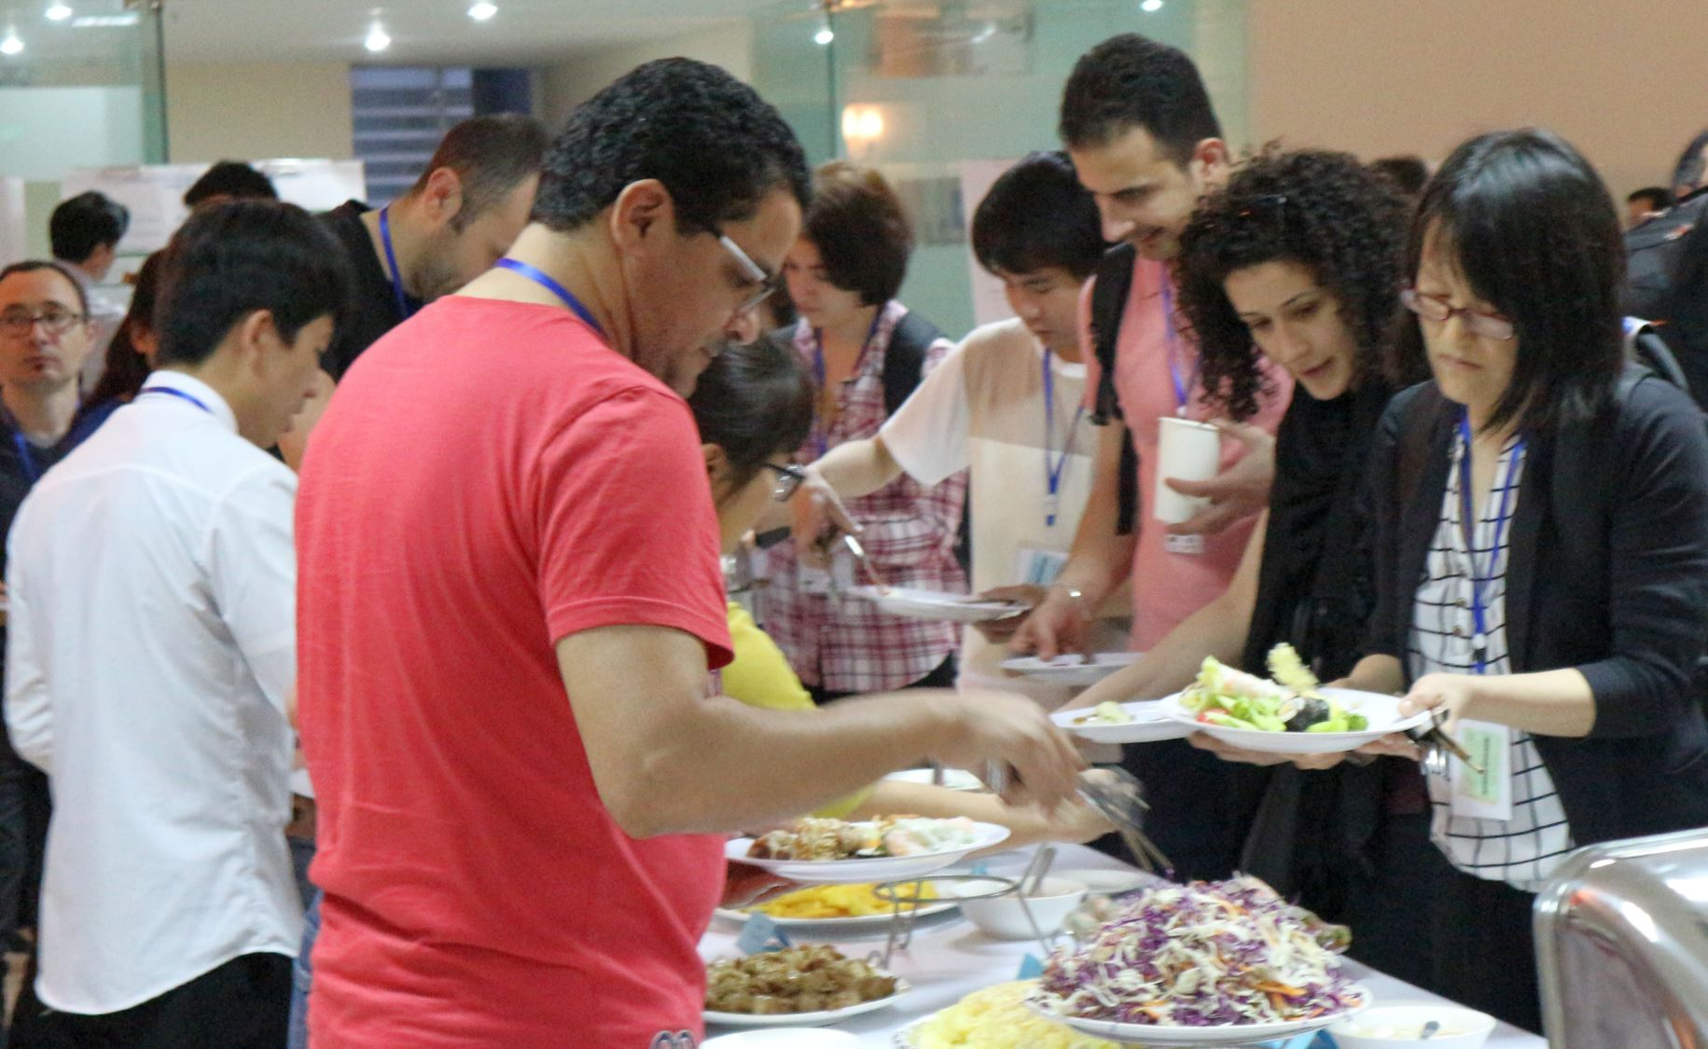

Slide 25
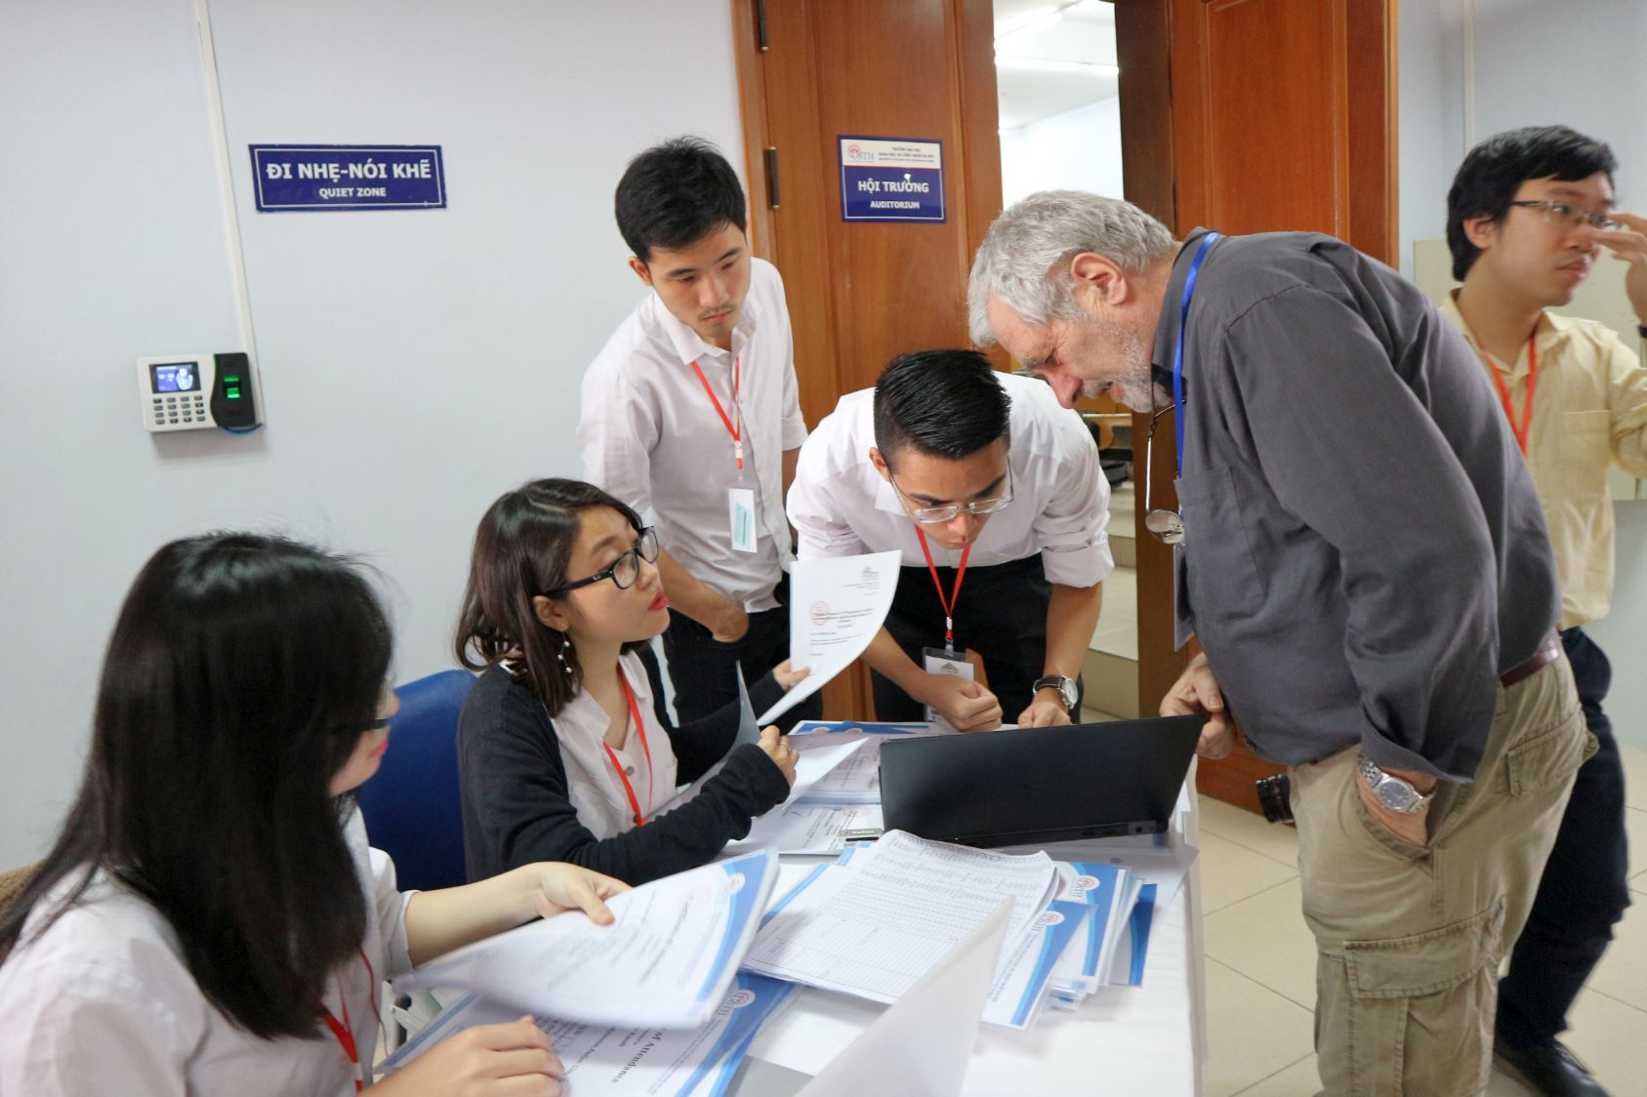

Slide 26
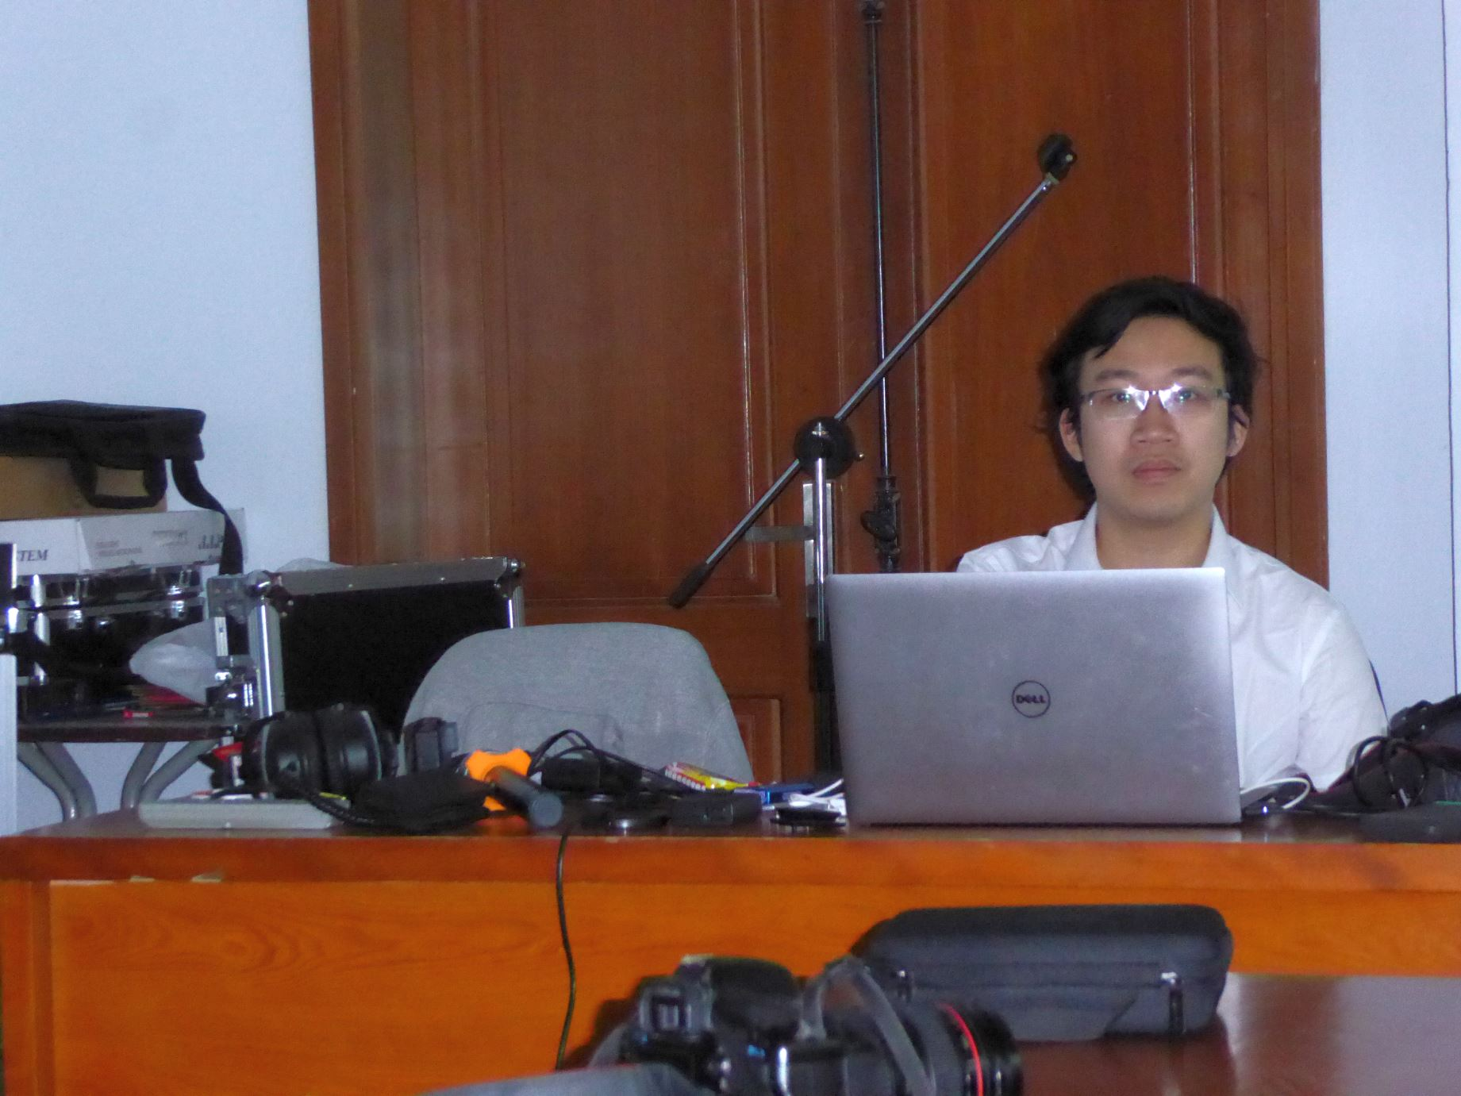

Slide 27
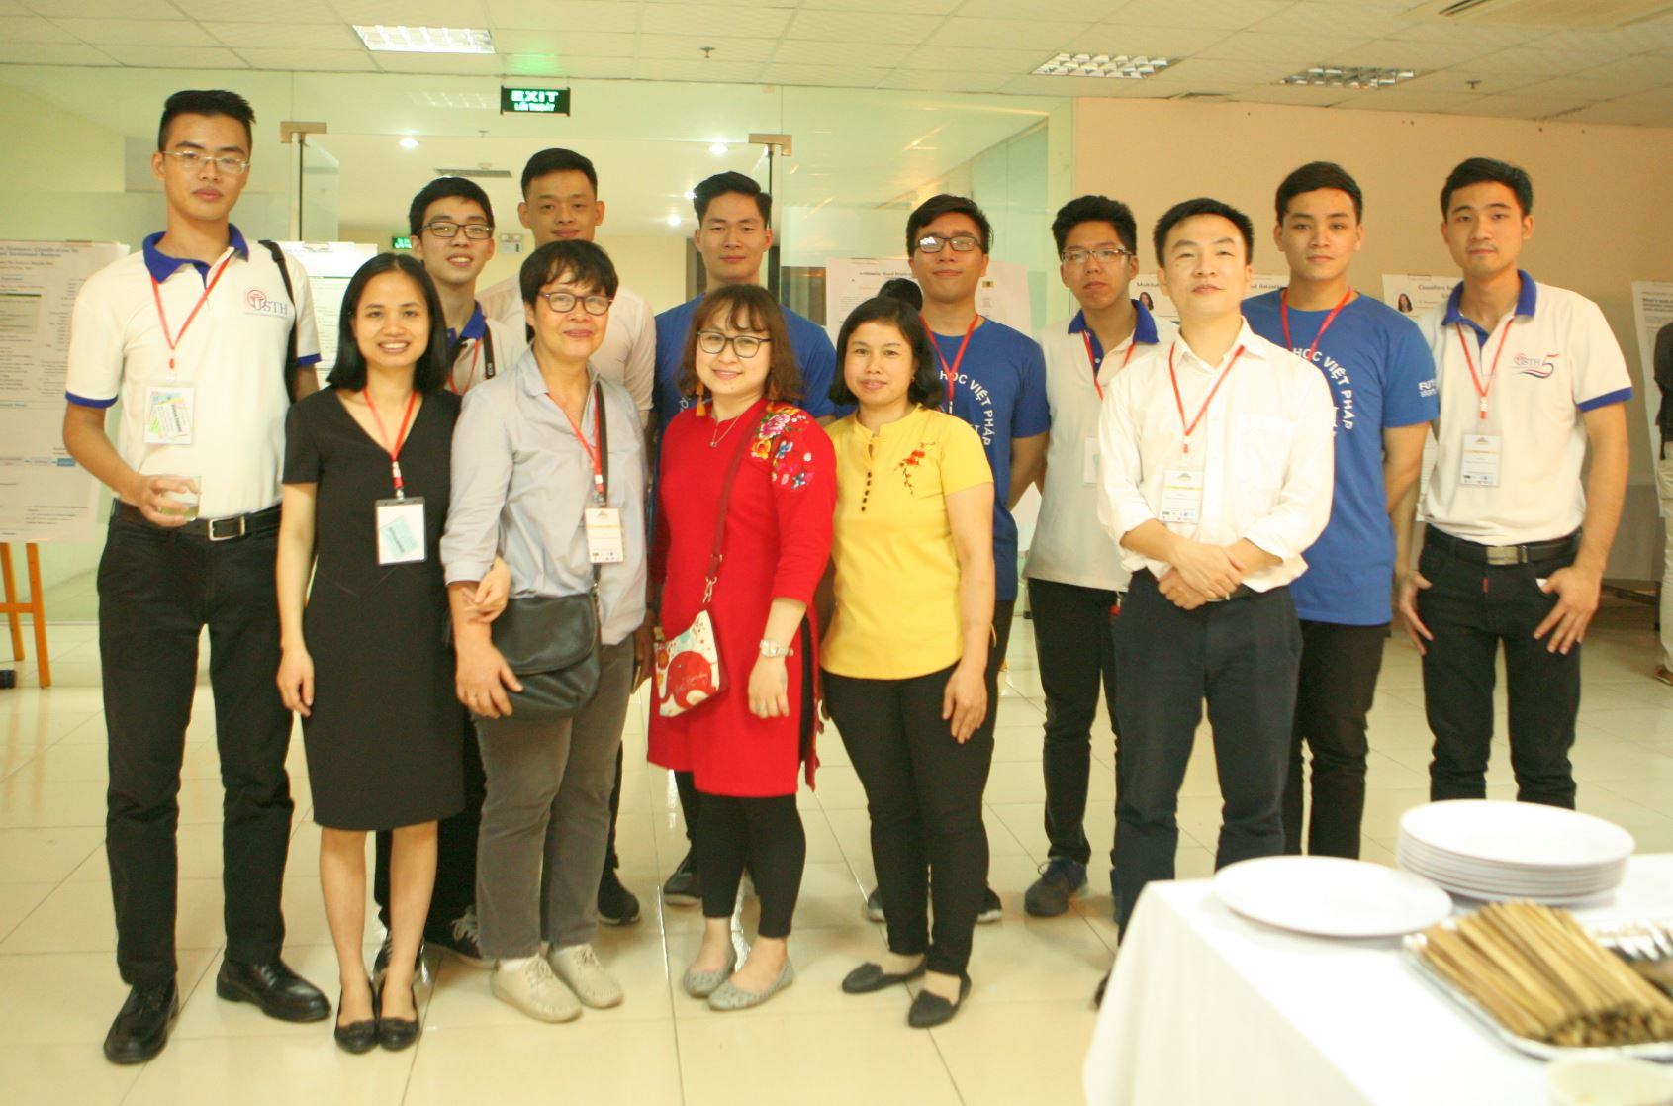

Slide 28
FAREWELL

Slide 29
WELCOME
CICLing 2019

Slide 31
“You will see, gentlemen, that we shall be fools enough to take _________.”
“You are right; and upon my soul, I would give my life for a hair,” said Athos. “Fortunately, the day after tomorrow we leave Paris. We are going according to all probability to _________.”
“We are returning to his Eminence, monsieur the Chevalier,” said Athos, advancing; “and you will please to accept the word of Monsieur d’Artagnan that he will go straight to _________.”

Slide 32
“You will see, gentlemen, that we shall be fools enough to take La Rochelle.”
“You are right; and upon my soul, I would give my life for a hair,” said Athos. “Fortunately, the day after tomorrow we leave Paris. We are going according to all probability to La Rochelle.”
“We are returning to his Eminence, monsieur the Chevalier,” said Athos, advancing; “and you will please to accept the word of Monsieur d’Artagnan that he will go straight to La Rochelle.”

Slide 37
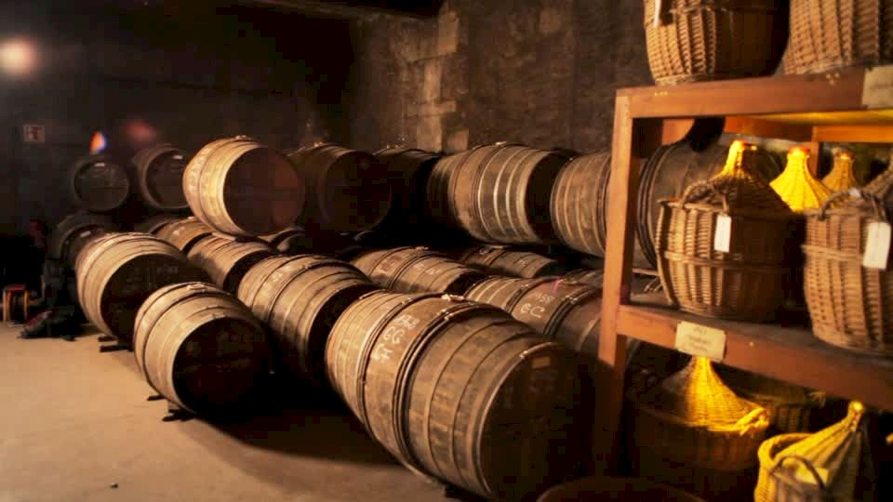

Slide 39
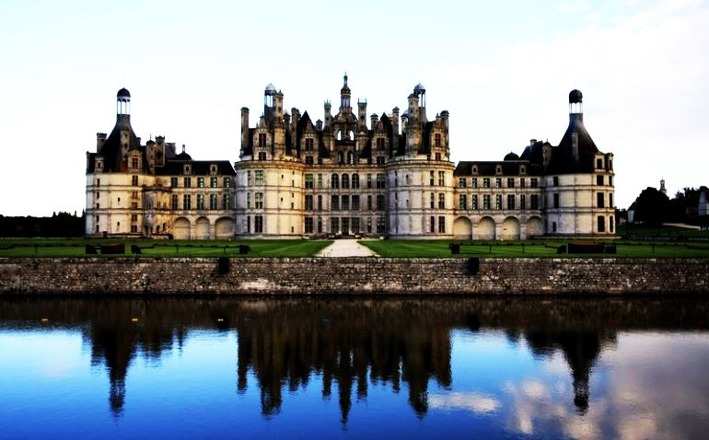

Slide 40
20th CICLing
CICLing 2019
April 7-13 (?)

Slide 42
See you all in La Rochelle!

