Slide 1
Are End-to-end Systems the Ultimate Solutions for NLP?
Jing Jiang
March 20, 2018
CICLing

Slide 2
Background
Recent years have witnessed a fast-growing trend of using deep learning solutions, oftentimes end-to-end, for NLP tasks.
Machine translation
Information extraction
Question answering
Abstractive summarization
Good performance
No feature engineering
Requires a large amount of training data
Hard to interpret

Slide 3
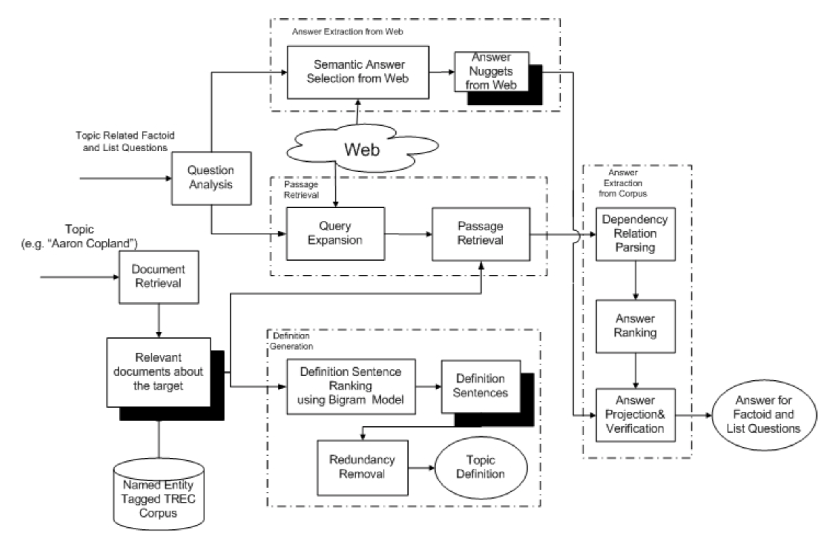
Example: Question Answering

Slide 4
Question Answering
named entity recognition
question type analysis
syntactic parsing
semantic parsing

Slide 5
End-to-end Question Answering
Starts from passages and questions as word sequences
Uses deep neural networks for encoding, matching and prediction
Does not need named entity recognition, question type analysis, syntactic parsing, etc.
On some benchmark dataset, best performance is close to human performance

Slide 6
SQuAD Leaderboard

Slide 7
Other Examples
Relation extraction
Traditionally feature engineering involves POS tagging, constituency parsing, dependency parsing, etc.
Recent work uses LSTM or CNN and position embedding, without feature engineering
Headline generation
Recent work uses sequence-to-sequence model trained on large amount of automatically obtained training data
Neural machine translation

Slide 8
End-to-end Systems
Advantages:
Eliminate the need to design subcomponents and features
Reduce error propagation
Results are good when sufficient training data is used

Slide 9
End-to-end Systems
Problems:
Require a large amount of training data, which may not always be readily available
Require careful tuning
May not be adaptable to a different dataset or domain / overfitting
Hard to interpret

Slide 10
End-to-end Systems
Do you believe end-to-end systems will become the ultimate solutions to all NLP applications?
Many intermediate steps such as morphological analysis, syntactic analysis or even discourse analysis would not be useful

Slide 11
End-to-end Systems
Or do you believe end-to-end systems have their limitations?
E.g, how do we share knowledge across different tasks?

Slide 12
What Are Your Thoughts?

Slide 13
How do you typically build your systems?
Feature engineering + traditional ML method (e.g., SVM)
Mixture of traditional method and NN (e.g., incorporate POS tagging and parsing features into a neural network)
End-to-end (i.e., no feature engineering)

Slide 14
Is NN model useful for your task?
Have not tried it yet
Tried but not useful
Useful through word embeddings only
Useful through models such as CNN and LSTM

Slide 15
Interpretability
Do you think interpretability is important?
Do you find it hard to interpret your NN model?
Does error analysis help you come up with ways to improve your NN model?

Slide 16
Tuning
Is a model considered good if it requires heavy tuning?
Parameter sensitivity study?

Slide 17
Benchmark datasets
Are we just chasing the numbers?
Statistical significance tests?

Slide 18
Challenges
What challenges do you face when adopting deep learning models for your NLP problem?

