Slide 5
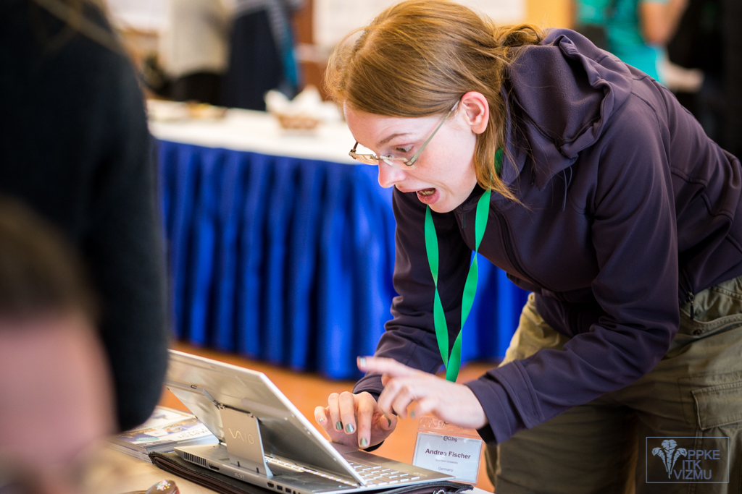

Slide 10
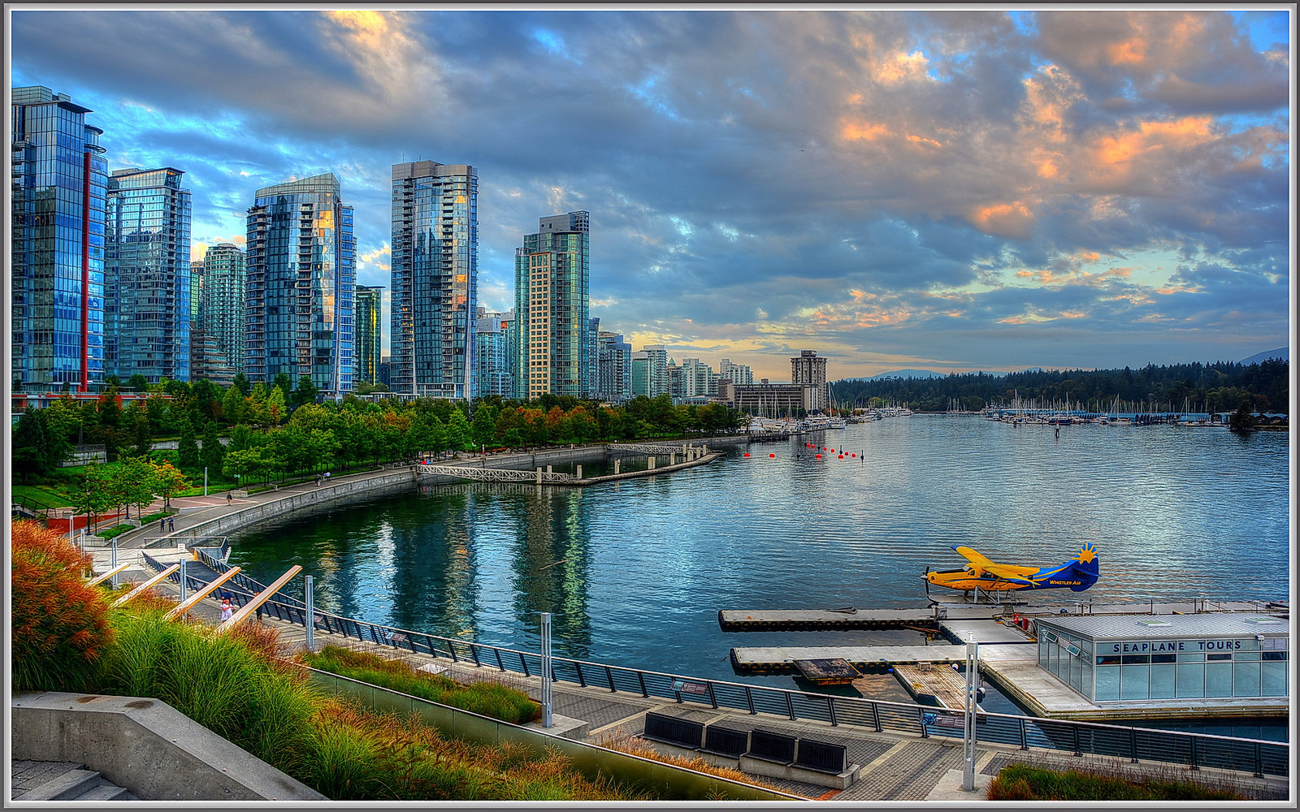
ACL 2017 – Vancouver, Canada
Conference Dates: July 30 - August 4, 2017
General Chair: Chris Callison-Burch
PC Chairs: Regina Barzilay, Min-Yen Kan

Slide 11
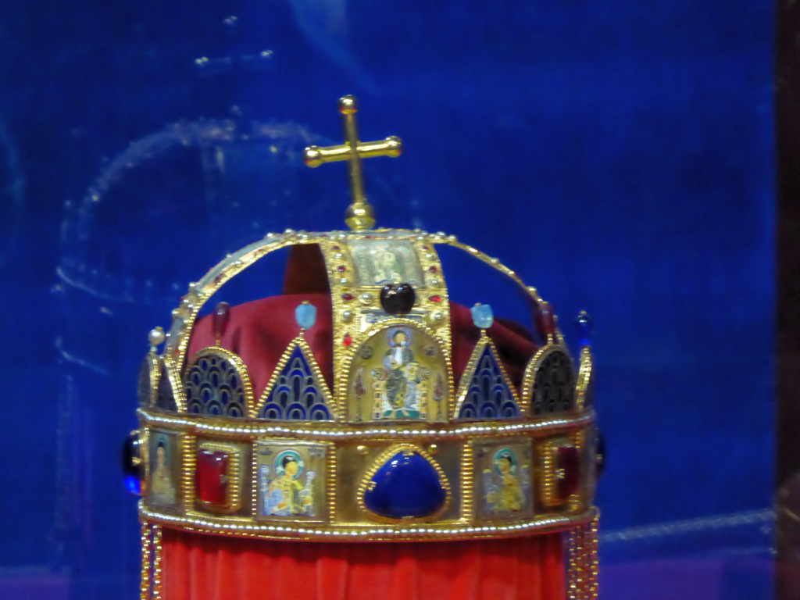

Slide 12
Ernő Rubik

Slide 13
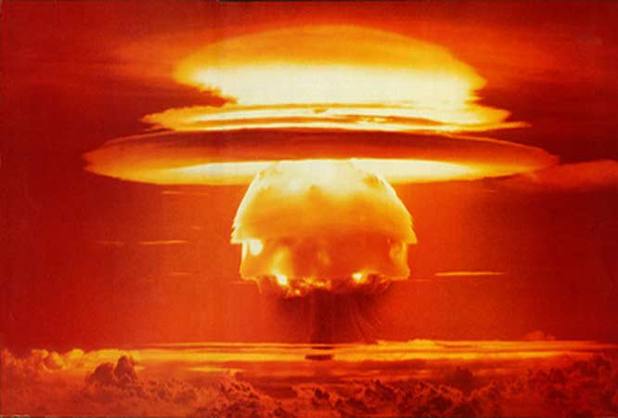
Edward Teller

Slide 14
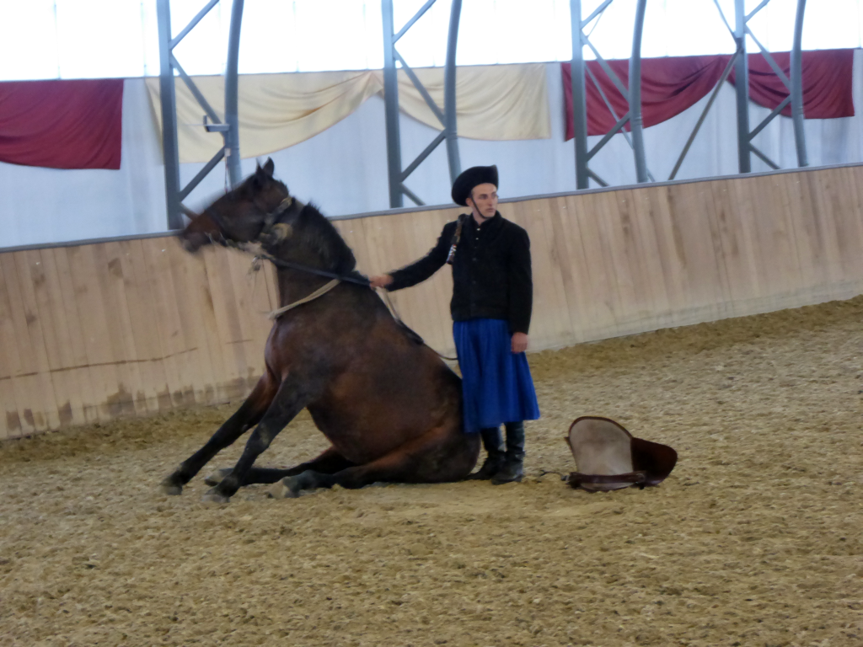

Slide 16
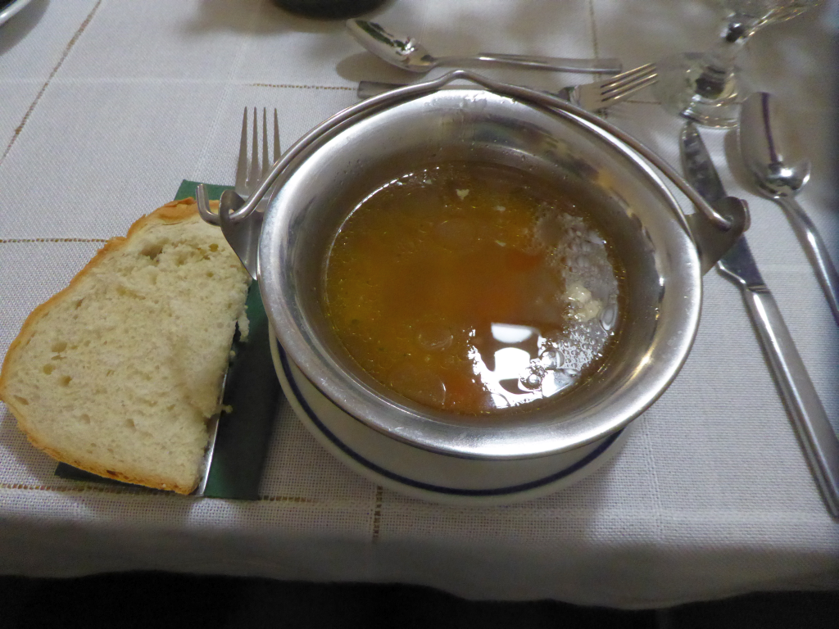

Slide 17
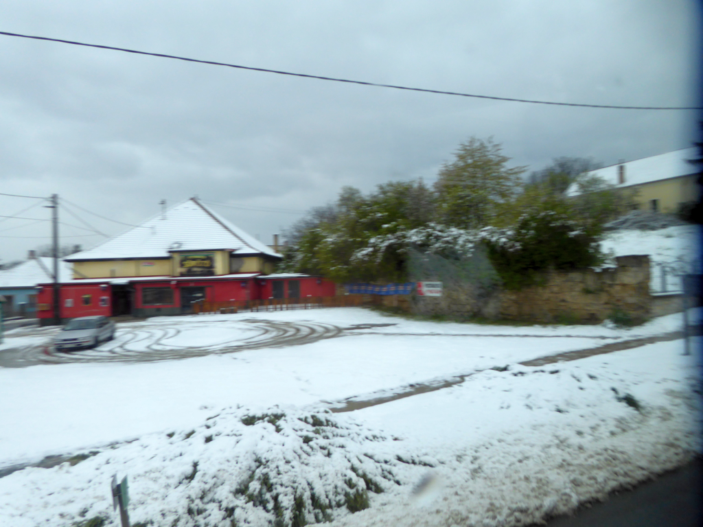

Slide 18
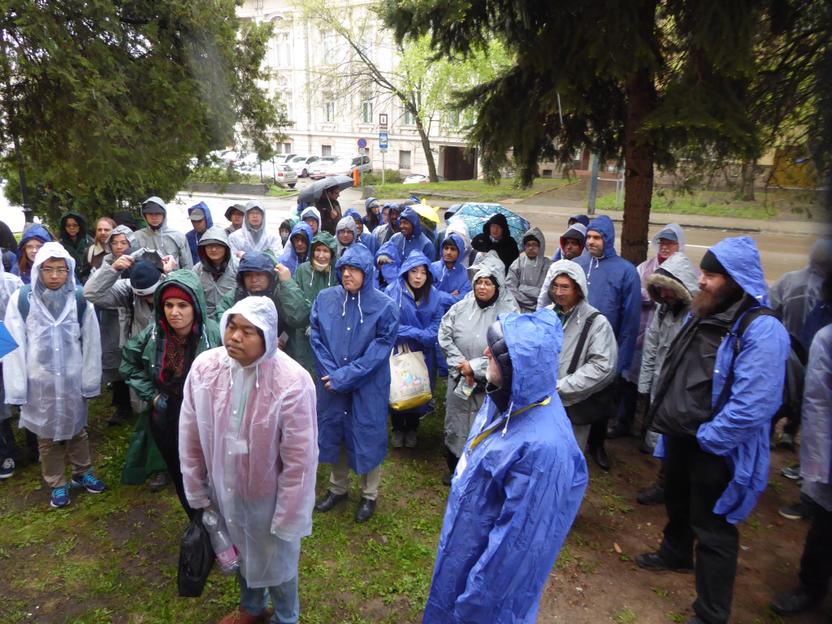

Slide 19
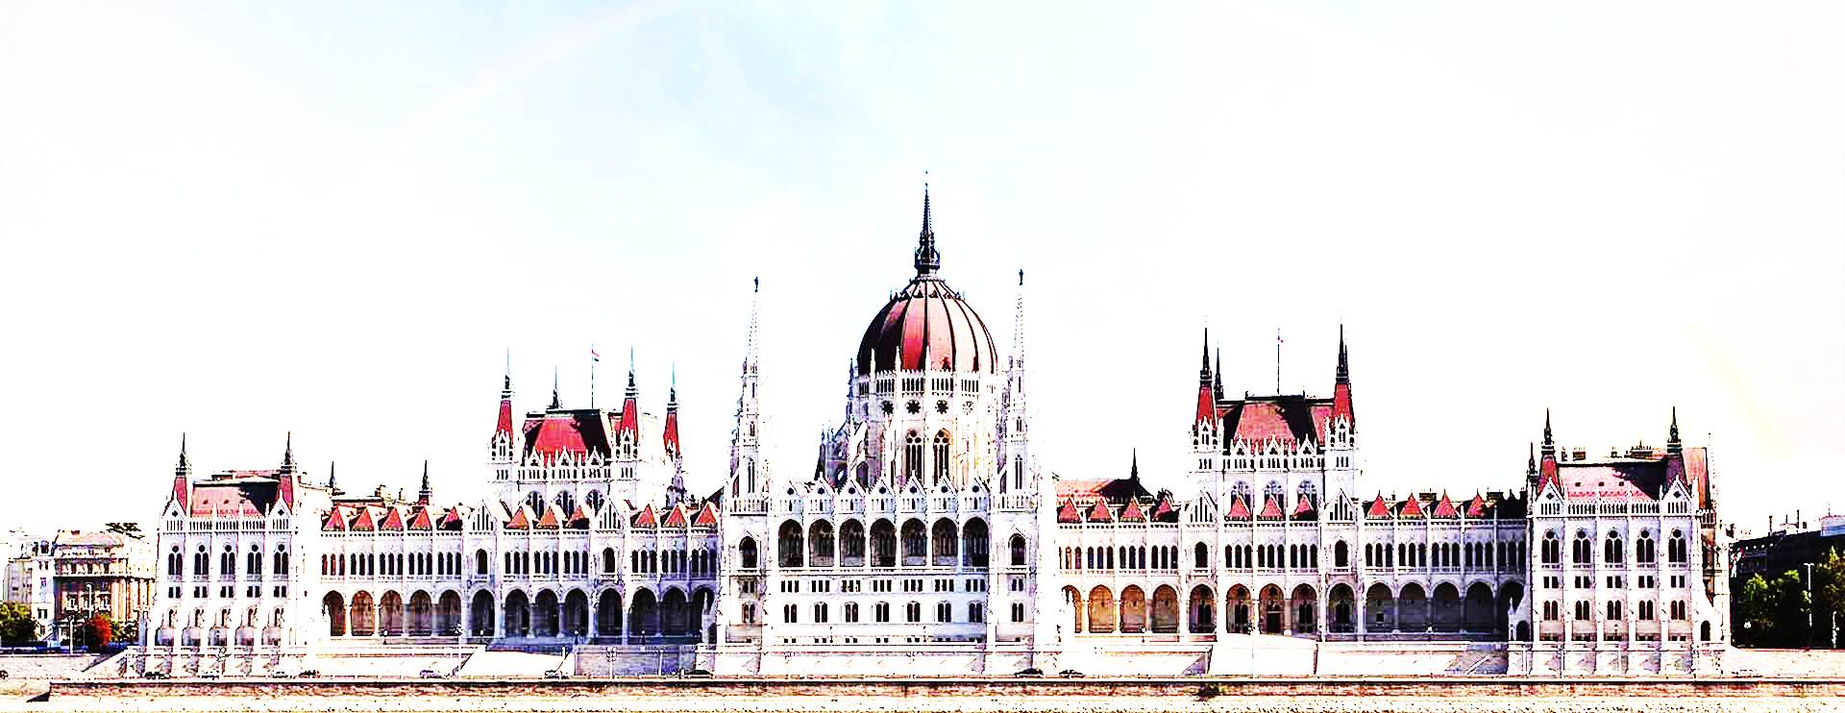
Búcsú – Farewell
2017

Slide 20
2018

Slide 21
France
Ireland
Norway
UK
Greece
Israel
Jordan
Mexico
Peru
India

Slide 26
Ho Chi Minh Mausoleum

Slide 27
Ho Chi Minh Mausoleum

Slide 29
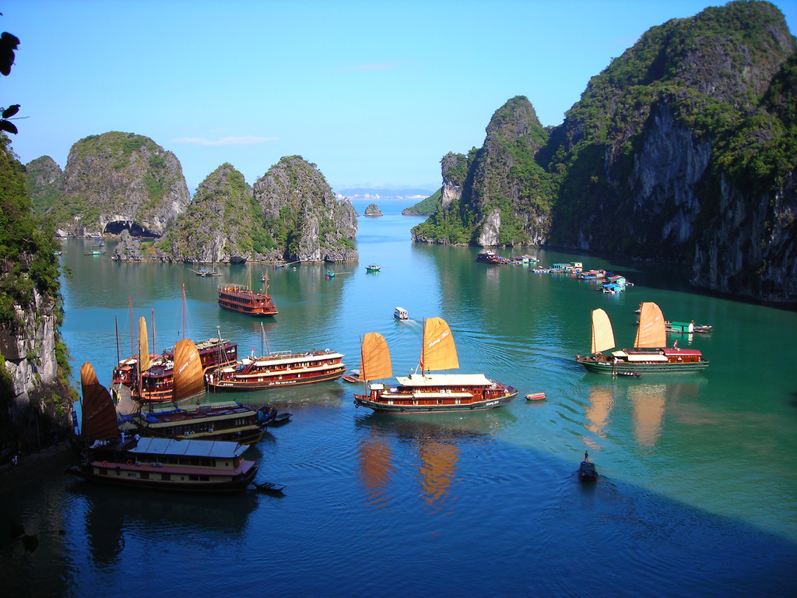
Ha Long Bay

Slide 30
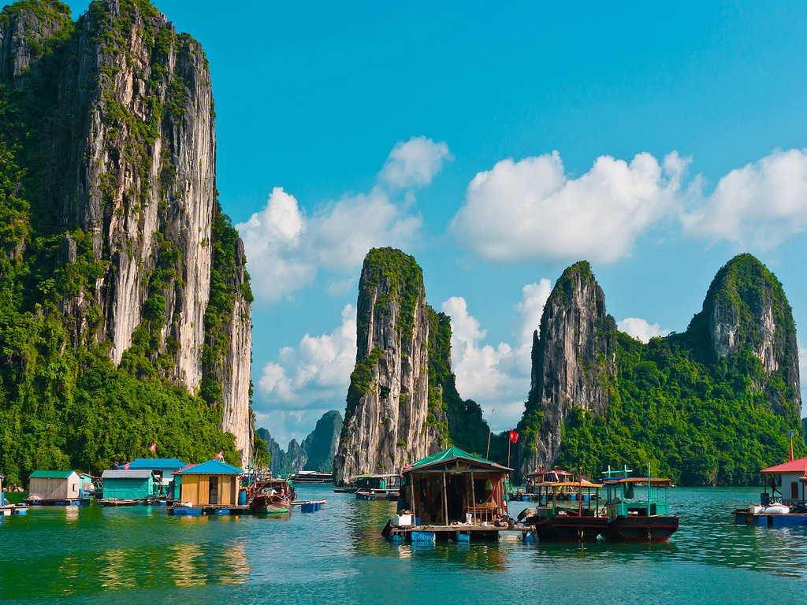
Ha Long Bay

Slide 31
Ha Long Bay

Slide 32
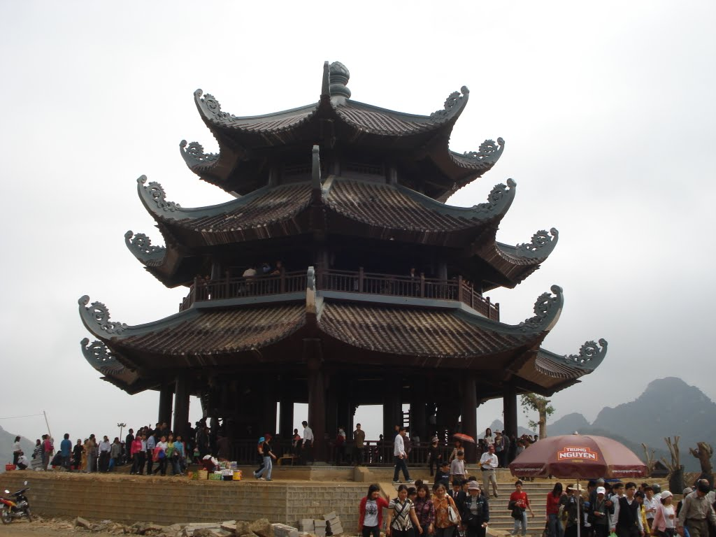
Bai Đinh near Trang An

Slide 33
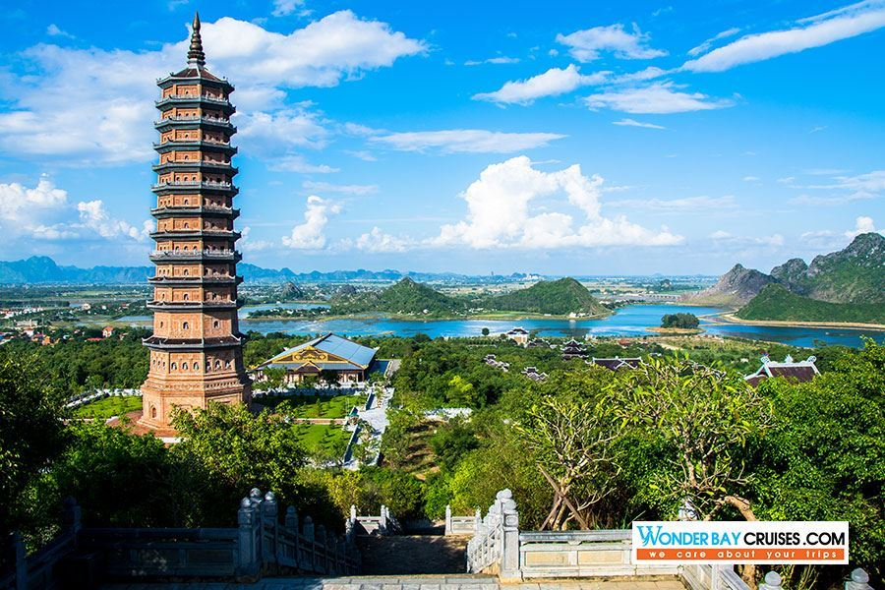
Bai Đinh complex

Slide 34
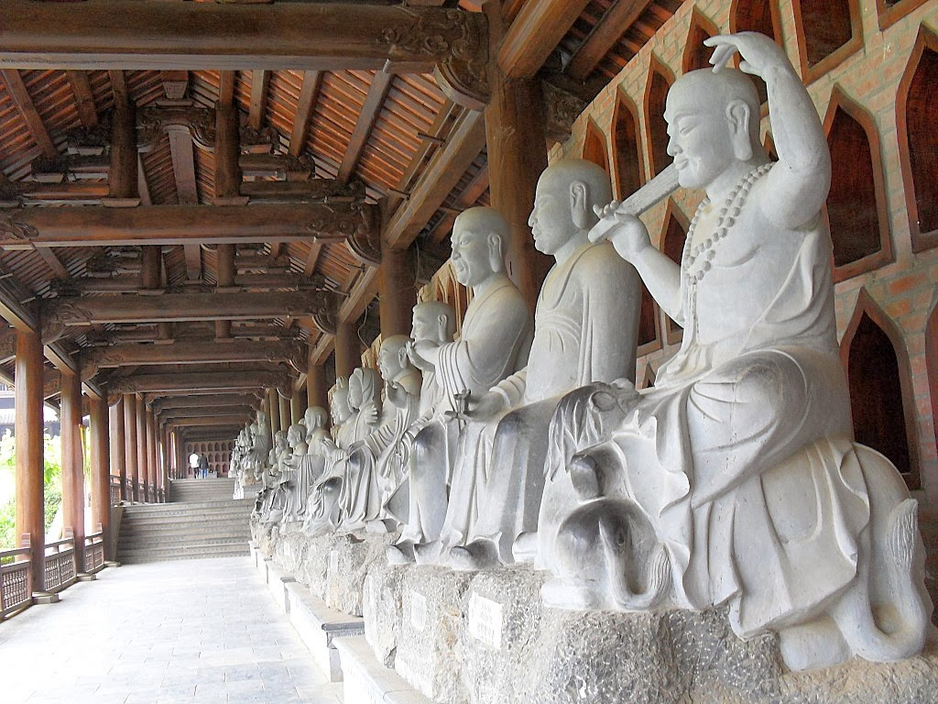
Trang An Complex

Slide 35
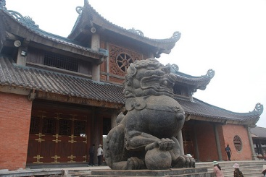
Bai Đinh complex

Slide 36
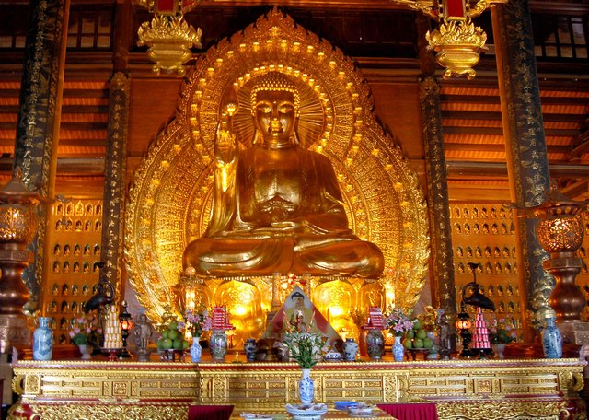
Bai Đinh complex

Slide 37
Bai Đinh complex

Slide 38
Trang An caves

Slide 39
Trang An rivers

Slide 40
University of Science and Technology

Slide 41
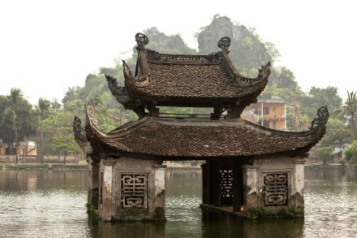
Sểế yộủ sởộn ịn Việt Nam!

